Slide 1
Summer Internship Project
Alan Li

Slide 2
What is the stock loan rate?
Whenever, we want to short a stock, we have to borrow the stock. Usually we borrow from Merrill Lynch. We pay them collateral for borrowing the stock, and they will pay us interest on the collateral.
However, for stocks that are extremely shorted, the interest rate can be extremely negative.
Make sure we’re not losing money!

Slide 3
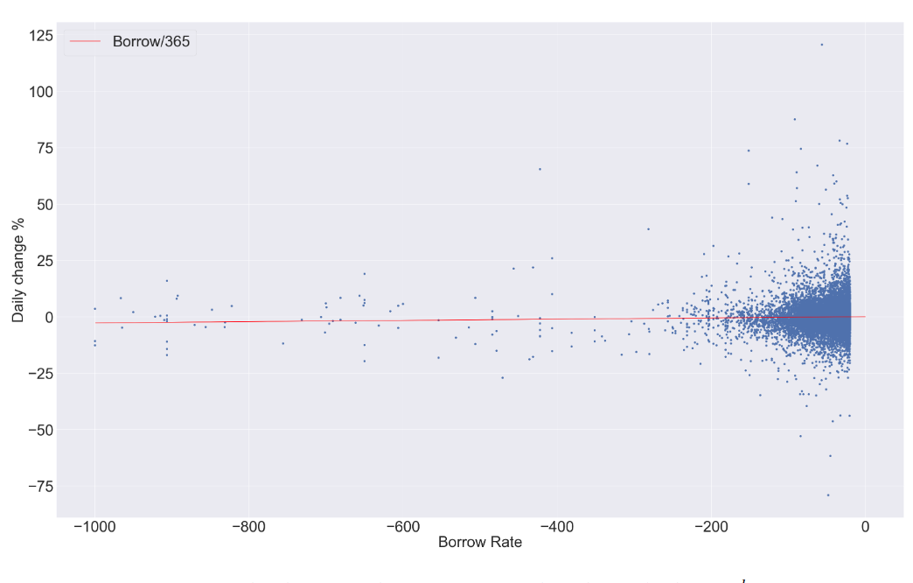
Comparing Loan Rate to Daily Change
We found that there was enough evidence to support that these two rates were different.
Markets are efficient!

Slide 4
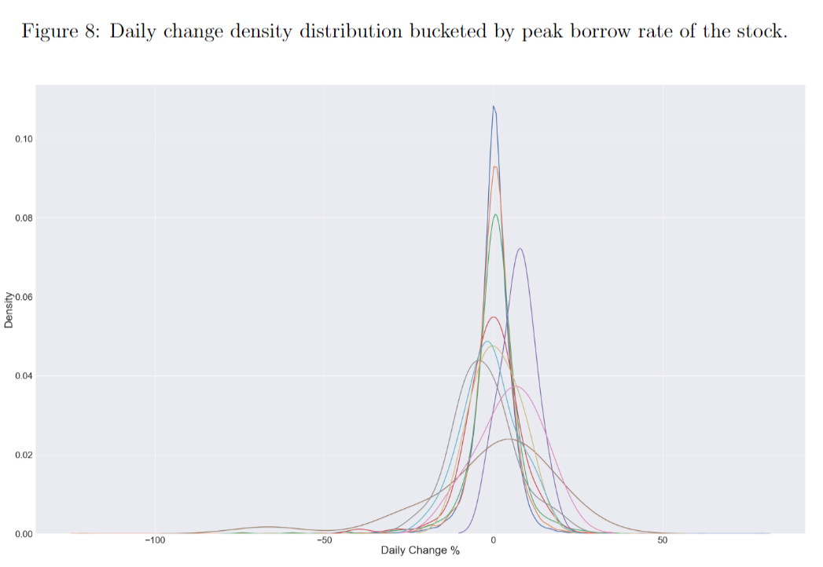
Can we use the loan rate to predict prices?
We found that we can expect a negative drift in the stock when the loan rate is extremely negative.

Slide 5
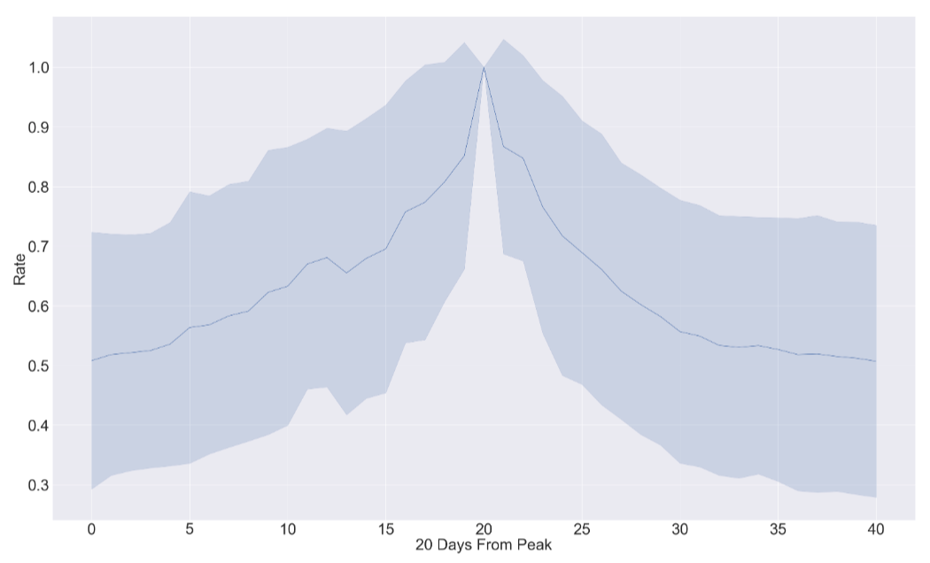
Modelling the rate
Curve is exponential 20 days out from peak negative rate.

